Slide 1


Introduction to Wireless Technologies
Bogdan Doinea
IoT Systems Engineer, Romania
bdoinea@cisco.com

Slide 2

Why is Wireless More and More important?
Wireless Technologies
CSMA/CA
Wireless Standards – 802.11 a/b/g/n
The new kid on the block – 802.11ac

Slide 3



Slide 4


Wi-Fi laptop
I can use Wi-Fi in the meeting room, but I lose signal if I move away
Everything else is wired
Wired Phone
I heard that some phones have Wi-Fi capabilities, but where would I use them?
4

Slide 5


I get Wi-Fi from home, the office, most public places, some streets
Multi Wi-Fi
More Applications
Like most people, I have 2 or 3 Wi-Fi devices
I rely on Wi-Fi for critical applications… and do not see why video is so slow…
5

Slide 6

802.11ac
802.11n
Everything uses Wi-Fi… Everything?
Far Reaching Wi-Fi
More Applications
I get Wi-Fi from almost everywhere
Everyone uses Wi-Fi… for almost everything
6

Slide 7

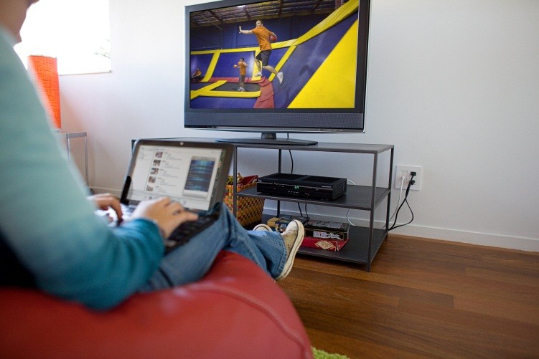

802.11ac -> 802.11ad
Your media server can stream to your TV, your laptop, your phone, your tablet… multiple streams everywhere in the house
802.11ah – Wireless for IoT
7
Wi-Fi is used to monitor your electricity, gas meters, industrial sensors (wind-mills etc.), hospital remote patients vitals, etc.
© 2012 Cisco and/or its affiliates. All rights reserved.
7
Cisco Confidential
7

Slide 8


















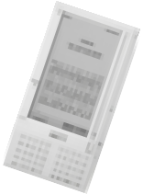
































































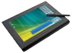




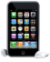













In 2020 there will be 50 billion connected devices
Smartphone & Tablet adoption growing 70%+ annually.**
•In 2014, more than 60% of network devices shipped without a wired port.***
TIME
▪▪Source: *ABI Research, **IDC, *** Morgan Stanley Market Trends
‹#›
8

Slide 9

‹#›
8

Slide 10
PAN/WPAN (Personal Area Network)
Bluetooth, IEEE 802.15.4
LAN (Local Area Network)
IEEE 802.11
MAN (Metropolitan Area Network)
IEEE 802.11, IEEE 802.16, IEEE 802.20
WAN (Wide Area Network)
GSM, CDMA, Satelite
http://www.ieee.org/index.html
10

Slide 11
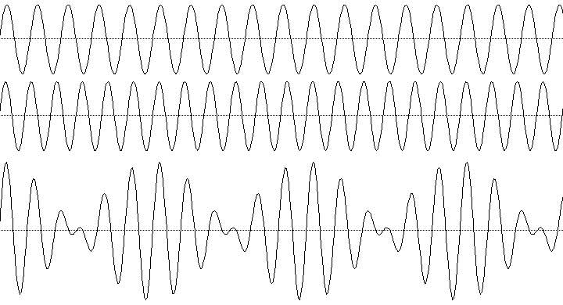


Wireless technologies use electromagnetic waves
What types of communication mediums do we have in wired networks?
Coper, Fiber
What communication medium do we have in wireless?
The Earth’s Athmosphere
11

Slide 12


Frequency (f - Hz)
Frequency is the number of occurrences of a repeating event per unit time.
Higher frequency: Greater speed Shorter range
High reflection rate
Higher absorption in the Earth’s atmosphere Higher costs

Slide 13

ISM – Industrial Scientific Medical
Free to transmit http://en.wikipedia.org/wiki/ISM_band
2,4 and 5 GHz bands
Disadvantage:
They are very occupied The frequencies are high
3 KHz
5.725-5.850
GHz
3 GHz
3 THz
 |  | Radiowaves |  |  |  |  |  | Microwaves
902-928
MHz
2.401-2.483
GHz
5.470-5.725
GHz

Slide 14
Encoding digital data into wireless signals (OFDM)
Higher bandwidth requires higher modulation techniques
Analog modulation: AM, FM, PM etc
Digital modulation: ASK, APSK, QAM-64 etc
Spread Spectrum: DSSS, FHSS, OFDM

Slide 15

Carrier-sense multiple access with collision avoidance

Slide 16
Wireless will always be half-duplex because of the communication environment
Similar to the 10-Base5 and 10-Base2 implementations
If 2 stations transmit at the same time, a collision will occur
Detectable by unsteady frequencies and incorrect modulation
The conclusion?
An access control method is needed for the wireless environment

Slide 17

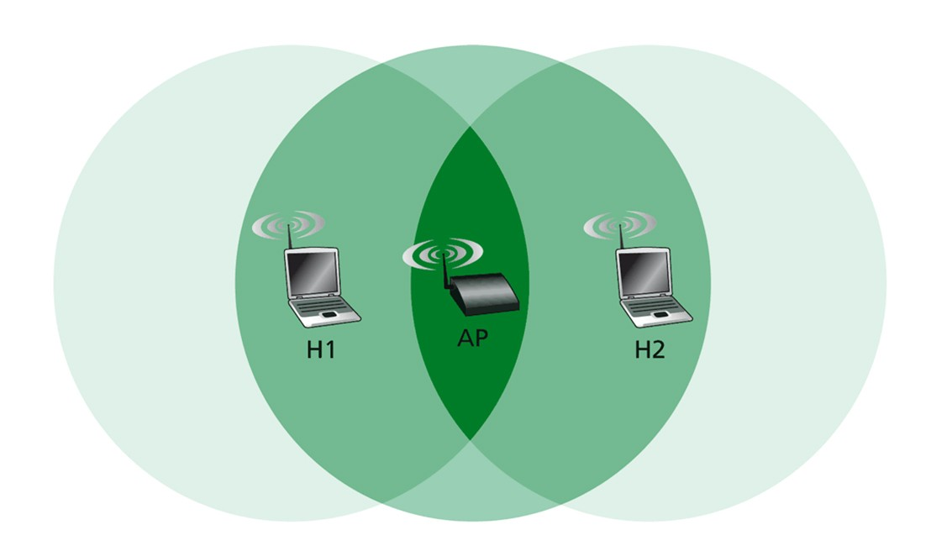
Carrier Sense Multiple Access with Collision Detect
Why not use CSMA/CD?

Slide 18
With ACK messages
For each frame sent an ACK message is required
If no ACK message is received, retransmission is done
With the RTC/CTS mechanism
Request to Send frame (RTS)
Clear To Send frame (CTS)
‹#›
18

Slide 19
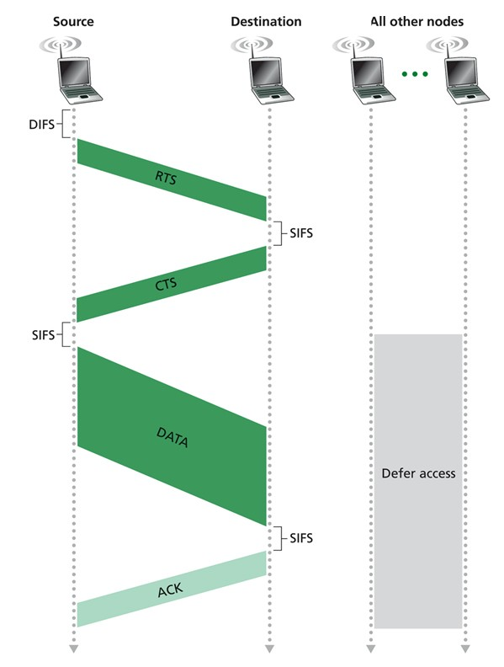
CSMA/CA
Carrier-Sense Multiple Access with Collision Avoidance
‹#›
19

Slide 20
The wireless transmition medium is shared
It is not possible to transmit in the exact same frequency without collisions
How many Hz do we need to transmit 54 Mbps in 802.11g?
Answer: 22 Mhz
Solution: we could split the ISM band into channels and map each WLAN/SSID on a single channel, thus having multiple networks in the same band
20

Slide 21

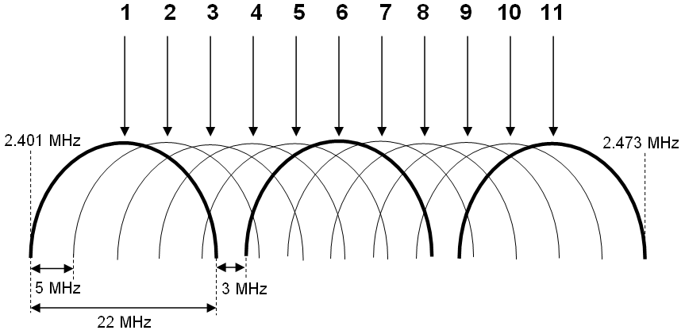
21

Slide 22
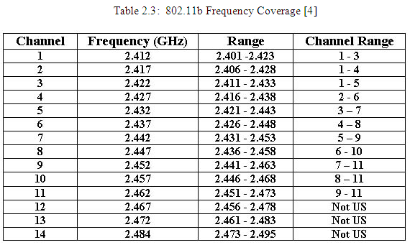

Slide 23
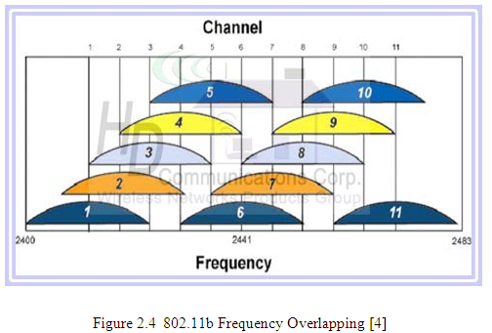

Slide 24














Channel 6
Channel 1
Channel 11
Channel 6
Channel 11
Channel 6
Channel 1
Channel 1
Channel 11
Channel 6
It is possible to cover any surface using just 3 channels

Slide 26

Legacy – released in 1997
Specified in infrared and wireless
Spread Spectrum – FHSS/DSSS
Speed: 1-2 Mbps
Frequency: 2.4 Ghz and 900 Mhz

Slide 27



Both standards appeared about the same time - 1999
• 802.11a
Introduces OFDM and takes speed up to 54 Mbps Frequency band: 5 GHz
Distance to transmit signal: 25m
• 802.11b
Bandwidth: 11 Mbps Frequency band: 2.4 GHz
Became very popular – called WiFi

Slide 28

Standardized in 2003
Best of both worlds (a & b)
Frequency band: 2.4 GHz
Bandwidth: 54 Mbps
Modulation: OFDM
Used for a long time and can still be found in networks

Slide 29
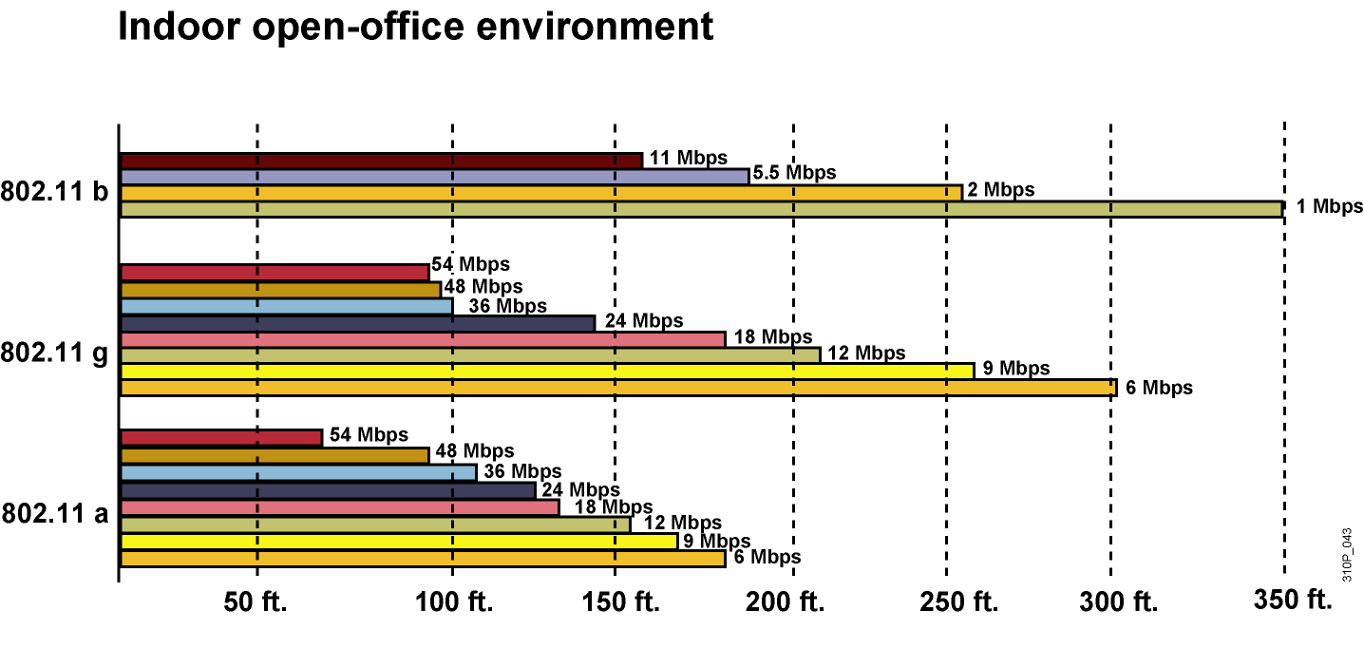
The measurement was made in indoor oﬃce spaces
‹#›
27

Slide 30

802.11n – standardized 29 October 2009
Far greater speeds: theoretical maximum 600 Mbps
Better coverage and density of the signal
Backwards compatible with 802.11 a/b/g
Uses multiple antenaes and MIMO technology
Increased channel width to 40 Mhz
Improved imunity to noise using complex modulation techniques
Support packet aggregation (one header for multiple data packets)
‹#›
28

Slide 31






MIMO uses DSP processors to multiplex and demultiplex the signal
radio
radio
radio
DSP
radio
DSP
radio
radio
‹#›
29

Slide 32




The multipath effect = the process in which many waves carrying the same information are reflected differently from surfaces and with varying clarity
In 802.11g, the DSP chose the wave with the best signal to noise ratio
Although I receive mul;ple waves, I am going to chose the one with the best quality and interpret it
30

Slide 33

Problem description: some weaker SNR waves are ignored even if there is the possibility that they contain relevant information
In 802.11n, MRC is implemented in the NIC’s DSP so that it takes all the waves and composes just one high-quality wave, thus increasing throughput
Concluding:
MRC is a client-side technology
If you have an 802.11n board in a 802.11g network, you will have higher-than- ordinary through
It’s like having a cat with multiple ears

Slide 34
Standard | 802.11a | 802.11b | 802.11g | 802.11n
Published | 1999 | 1999 | 2003 | 2009
Frequency | 5GHz | 2.4GHz | 2.4GHz | 2.4GHz / 5GHz
Bandwidth | 54Mbps | 11Mbps | 54Mbps | 160-600 Mbps
Modulation | OFDM | DSSS | OFDM, DSSS | OFDM
Coverage Interior Exterior | 35m 120m | 38m 140m | 38m 140m | 70m 250m
Advantages | Strong signal in a small office | Low price | Good speed and good coverage | Very big speed Very big coverage
Disatvantages | Incompatible with g and b | Interference | Interference | More expensive

Slide 35


Slide 36
How to Increase Speed Without Making it Impossibly Difficult?
▪▪ Increase channel width… beyond 40 MHz
▪▪ Increase number of spatial streams… more than 4
▪▪ Improve the modulation? Is 64-QAM the best we can do?
▪▪ Better manage the cell
▪▪ 5 Ghz band – in 2015 it’s the perfect thing to have
▪▪ Cost does not vary with freq anymore
▪▪ It’s not as populated as 2.4
▪▪ It’s a bigger space
▪▪ Why would only one device send at a time?
▪▪ If we can have one device send 3 streams at the same time on the same frequency, why not have 3 devices send 1 stream at the same time on the same frequency instead?
34

Slide 37







MU-MIMO
▪▪ 2 clients can receive signals at the same time, on the same frequency
▪▪ Each client has a dedicated spatial stream
▪▪ No collisions anymore
▪▪ “Full-duplex” becomes possible
“abc”
MIMO AP
“123”
35

Slide 38

Beyond the 1 Gbps Bar
▪▪ 160 MHz-wide channel width…
▪▪ Up to 160 MHz for APs
▪▪ 80 MHz for stations, 160 MHz optional
▪▪ More spatial streams
▪▪ Up to 8 spatial streams
▪▪ 8 radio circuits sending or receiving
▪▪ Better modulation
▪▪ QAM-256
(8 bits per symbol vs. 6 bits for QAM-64) Up to 4 times faster
‹#›
36

Slide 39
MCS
Modulati on
Ratio
20 MHz channel
40 MHz channel
80 MHz channel
160 MHz channel
800 |  |  | ns | 400 ns | 800 ns | 400 ns | 800 ns | 400 ns | 800 ns | 400 ns
 |  |  | GI | GI | GI | GI | GI | GI | GI | GI
0 | BPSK | 1/2 | 6.5 | 7.2 | 13.5 | 15 | 29.3 | 32.5 | 58.5 | 65
1 | QPSK | 1/2 | 13 | 14.4 | 27. | 30 | 58.5 | 65 | 117 | 130
2 | QPSK | 3/4 | 19.5 | 21.7 | 40.5 | 45 | 87.8 | 97.5 | 175.5 | 195
3 | 16-QAM | 1/2 | 26 | 28.9 | 54 | 60 | 117 | 130 | 234 | 260
4 | 16-QAM | 3/4 | 39 | 43.3 | 81 | 90 | 175.5 | 195 | 351 | 390
5 | 64-QAM | 2/3 | 52 | 57.8 | 108 | 120 | 234 | 260 | 468 | 520
6 | 64-QAM | 3/4 | 58.5 | 65 | 121.5 | 135 | 263.3 | 292.5 | 526.5 | 585
7 | 64-QAM | 5/6 | 65 | 72.2 | 135 | 150 | 292.5 | 325 | 585 | 650
8 | 256-QAM | 3/4 | 78 | 86.7 | 162 | 180 | 351 | 390 | 702 | 780
9 | 256-QAM | 5/6 | N/A | N/A | 180 | 200 | 390 | 433.3 | 780 | 866.7
‹#›
37

Slide 40


Thank you.

